Slide 1
WEBMONK (DAY - 2) 💻
Topics covered:
* Dev Environment Setup * HTML (Basics, Document Structure, Anatomy of tags, Mostly used tags, Special Characters)
* Semantic HTML (HTML5 Guidelines, new additions, small HTML Blog project)
* CSS Intro, anatomy & usage
* Attributes & Selectors
* Unit Introduction
* Box Model * Media Queries

Slide 2
DEV ENVIRONMENT SETUP

Slide 3
Signup for GitHub account.
Any updated browser.
VS Code setup & extensions (Emmet, Live Server & HTML CSS Support)

Slide 4
HTML

Slide 5
BASICS OF HTML
HTML – HyperText Markup Language
Created in 1991 by Tim Berners-Lee, known as founding father of modern Internet.
Initial version released in 1993.
Managed by W3C.
Latest version: HTML5

Slide 6
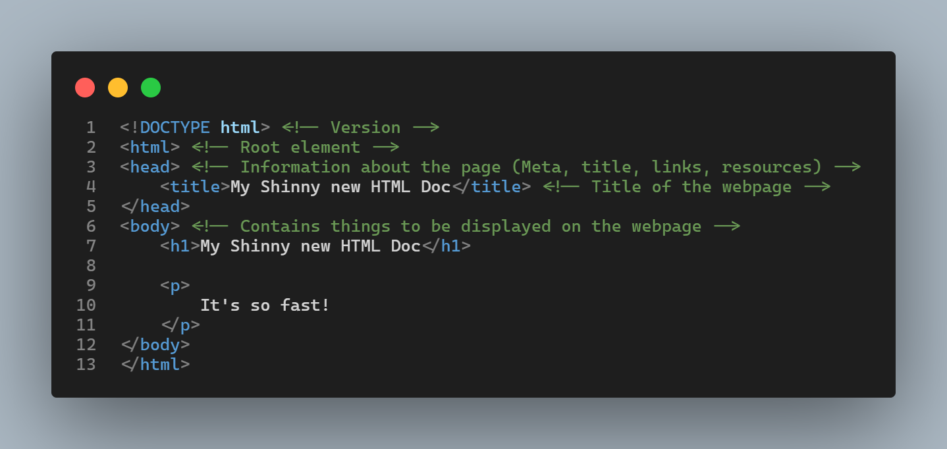
BASIC DOCUMENT STRUCTURE
* This is basic HTML required to view in browser.
* HTML is rendered sequentially from top to bottom.
* Let’s learn a little about this syntax

Slide 7
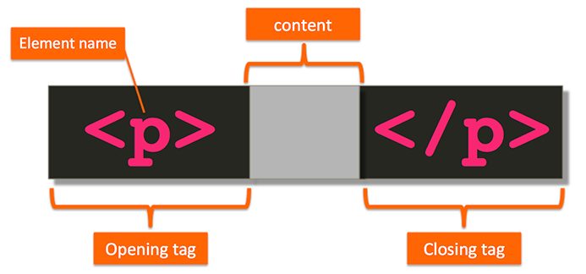
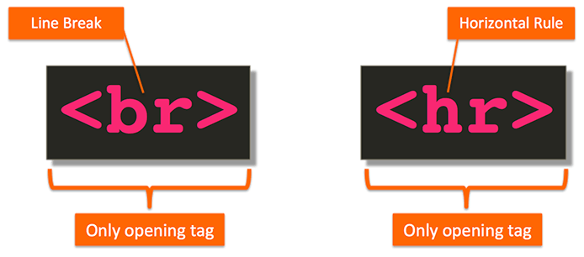
ANATOMY OF HTML TAG
* HTML markup consists of tags that describe the content and tell the browser how to structure & display it.
* A pair of HTML tags and their enclosed content are collectively called an element.

Slide 8
DIFFERENT TYPES OF ELEMENTS
BLOCK LEVEL ELEMENT
INLINE ELEMENTS
Render to begin on a new line (by default)
May contain inline or other block-level elements
For ex: <div>, <p>, <h1>-<h6>, <ul>, <ol>, <li>
Render on the same line (by default)
May only contain other inline elements
For ex: <a>, <b>, <strong>, <img>, <span>

Slide 9
MOSTLY USED TAGS
<h1>, <h2>..,<h6> tag - HTML headings
<p> tag – Paragraph
<img> tag – Image on page
<!-- --> tag – For comments in code
<br> tag – Line Break
<a> tag – Links in HTML document
<sup>, <sub> tag – Superscript & Subscript small text respectively.
<strong>, <em> tag – Text formatting (bold & italic respectively).
<ul>, <ol> tag – Unordered & ordered lists
<table> tag – Table in HTML document
<div> tag – Division tag used as a block in a document used mainly to layout sections in the design of the page.
<input> tag – To take different kinds of input from user.
<form> tag – Form for user input which wraps the input fields.
<style> tag - Wraps or includes CSS code.
<script> tag – Wraps or includes JS code.

Slide 10
SEMANTIC HTML

Slide 11
WHAT SEMANTIC ELEMENTS MEANS?
Introduced in HTML5.
These describes the meaning of element to both the browser and the developer.
These are block level element.
These helps in accessibility features.
For Ex: <article>, <aside>, <footer>, <header>, <main>, <nav>, <section>

Slide 12
CSS INTRO, ANATOMY & USAGE

Slide 13
INTRODUCTION TO CSS
CSS stands for Cascading Style Sheets.
CSS was first proposed by Håkon Wium Lie on October 10, 1994. At the time, Lie was working with Tim Berners-Lee at CERN.
Initial version released in 1996.
Managed by W3C.
Latest version: CSS3.
CSS describes how HTML elements are to be displayed on screen, paper, or in other media.
HTML – Structure, CSS – Layout & Look.
There is a saying: Everyone’s CSS is different.

Slide 14
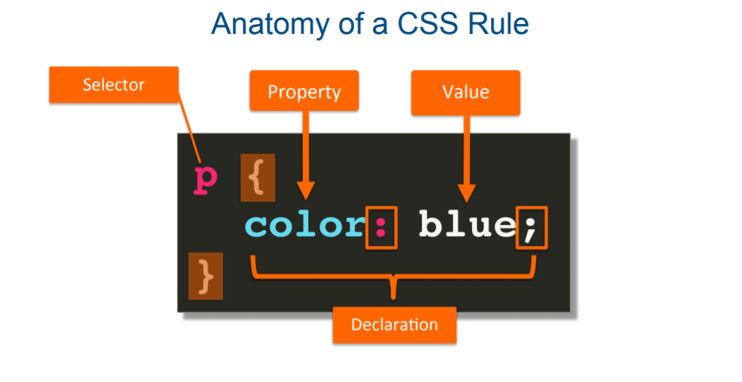
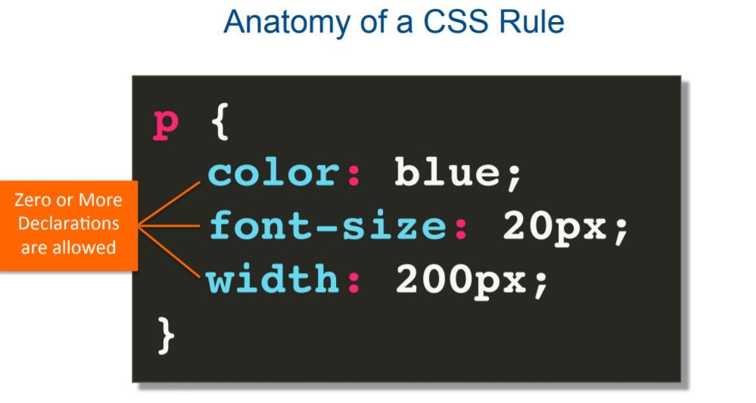
ANATOMY OF CSS
CSS properties and values are enclosed inside the braces`{ }` .
Property and value together are known as declaration.
We can define as many declarations we want inside a single selector.

Slide 15
USAGE OF CSS
Inline CSS
Internal CSS
External CSS

Slide 16
ATTRIBUTE & SELECTORS

Slide 17
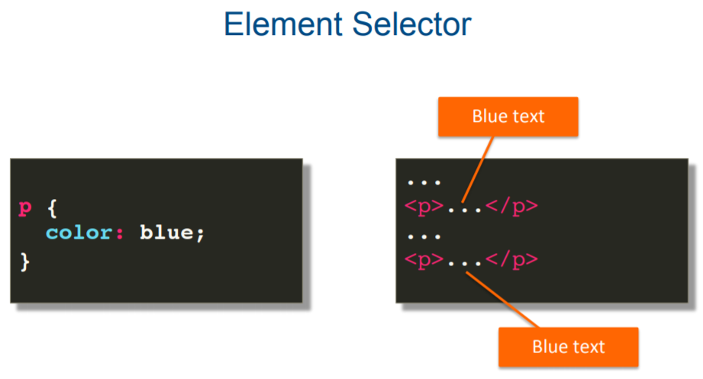
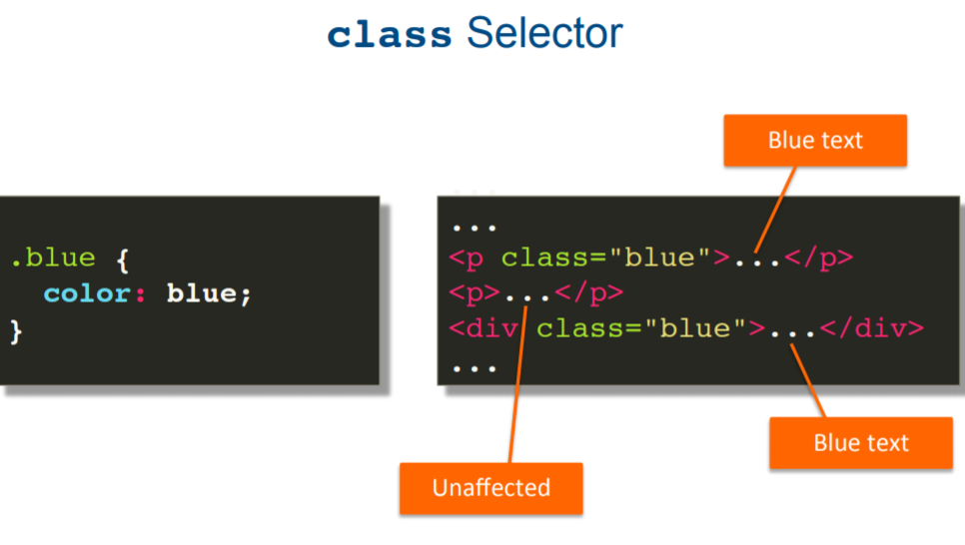
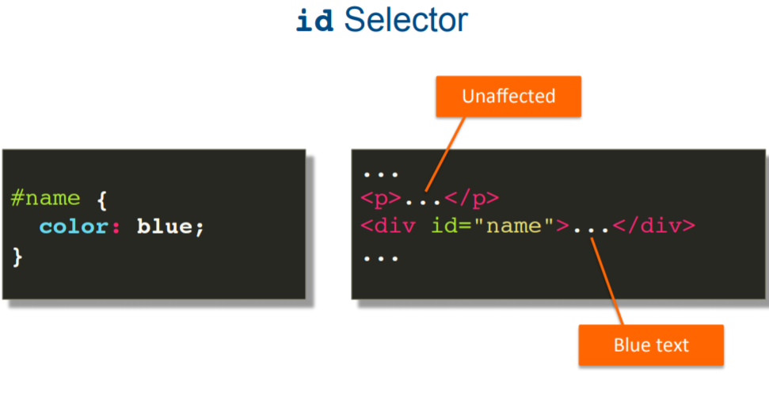
CSS SELECTORS
element, class & id Selectors

Slide 18
UNIT INTRODUCTION

Slide 19
PIXELS, PERCENTAGE, EM, REM
Pixel – Absolute unit of measurement. Broadly speaking, one pixel represents one dot on the screen.
Percentage – Relative unit of measurement compared to outer block level element.
Em – Relative unit of measurement compared to immediate parent element. 1em = 16px, which is also default browser font size.
Rem – Relative unit of measurement compared to root. 1rem = 16px, which is also default browser font size.

Slide 20
BOX MODEL

Slide 21
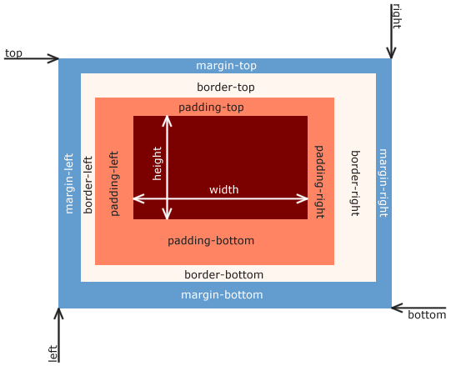
BOX MODEL INTRODUCTION
* the CSS box model refers to how HTML elements are modeled in browser engines and how dimension of those HTML elements are derived from CSS properties.
* each of those boxes has five modifiable dimensions:
- the height and width describe dimensions of the actual content of the box (text, images, ...)
- the padding describes the space between this content and the border of the box
- the border is any kind of line (solid, dotted, dashed...) surrounding the box, if present
- the margin is the space around the border

Slide 22
MEDIA QUERY

Slide 23
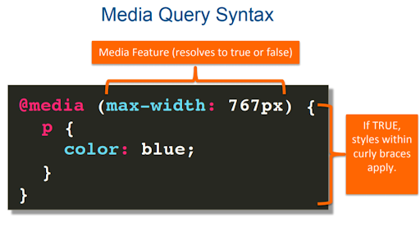
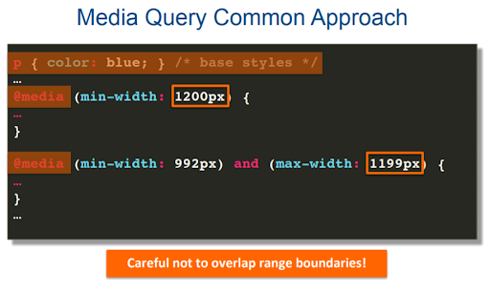
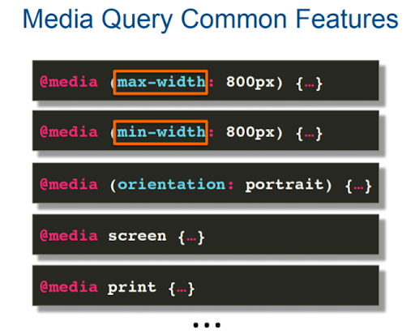
MEDIA QUERY
element, class & id Selectors

Slide 24
Some common responsive breakpoints
@media (min-width:320px) { /* smartphones, iPhone, portrait 480x320 phones */ }
@media (min-width:481px) { /* portrait e-readers (Nook/Kindle), smaller tablets @ 600 or @ 640 wide. */ }
@media (min-width:641px) { /* portrait tablets, portrait iPad, landscape e-readers, landscape 800x480 or 854x480 phones */ }
@media (min-width:961px) { /* tablet, landscape iPad, lo-res laptops ands desktops */ }
@media (min-width:1025px) { /* big landscape tablets, laptops, and desktops */ }
@media (min-width:1281px) { /* hi-res laptops and desktops */ }

